Slide 1

Riding the wave
How Europe can gain from the rising tide of scientific data a vision for 2030
Final Report of the High Level Expert
Group on Scientific Data to be launched 6 Oct 2010
John Wood, Chair

Slide 2

Digital Agenda for Europe the policy context
“The Digital Agenda for Europe outlines policies and actions to maximise the benefit of the digital revolution for all. Supporting research and innovation is a key priority of the Agenda, essential if we want to establish a flourishing digital economy.”
  Neelie Kroes,
  Vice-President of the European Commission, responsible for the Digital Agenda

Slide 3

Rising tide of data…
“A fundamental characteristic of our age is the raising tide of data – global, diverse, valuable and complex. In the realm of science, this is both an opportunity and a challenge.”
  Report of the High-Level Group on Scientific Data, October 2010
  “Riding the Wave: how Europe can gain from the raising tide of scientific data”

Slide 4

e-Infrastructures underpinning a creativity machine…
“We humans have built a creativity machine. It’s the sum of three things: a few hundred million of computers, a communication system connecting those computers, and some millions of human beings using those computers and communications.”
  Vernor Vinge
  (Nature, Vol 440, March 2006)

Slide 5
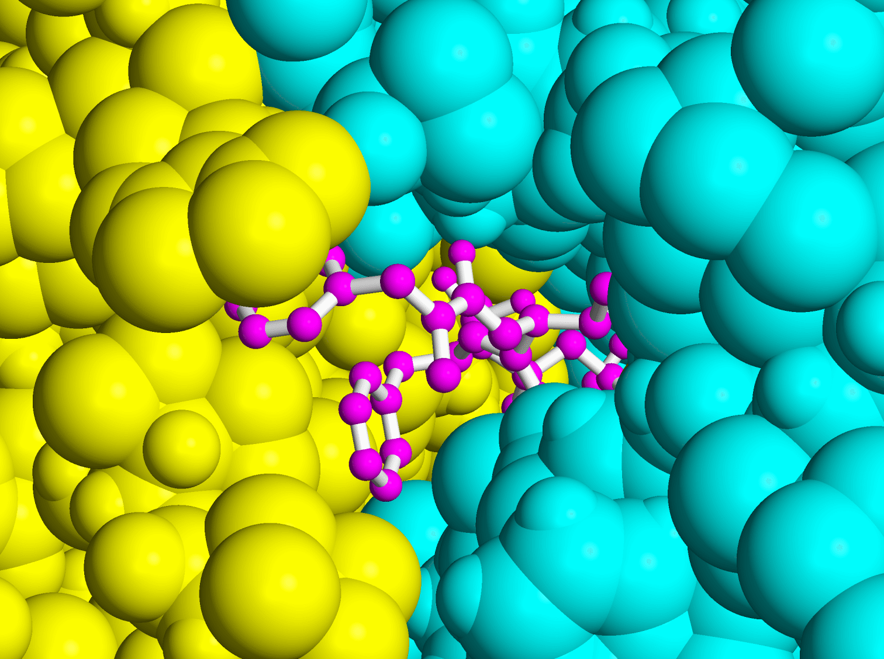
Science and ICT Technologies
High-speed communications and advance computation give rise to the era of e-Science.
During the 2006 pandemics alarm, Asian and European laboratories analysed drug components against avian flu using thousands of computers distributed in network grid during 4 weeks!
This work would have taken 100 years on a single computer!

Slide 6
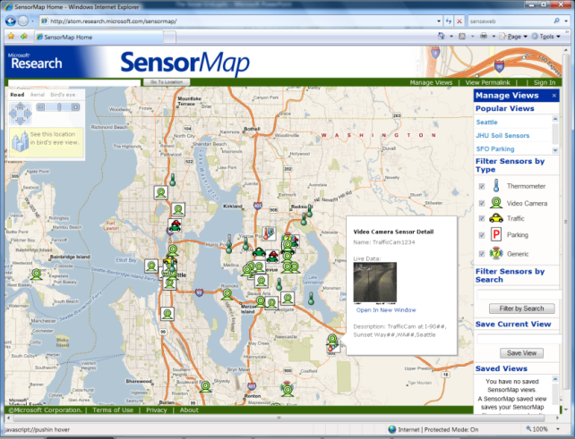
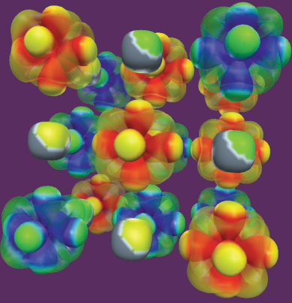
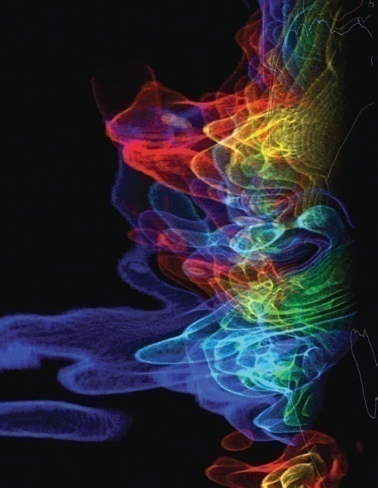
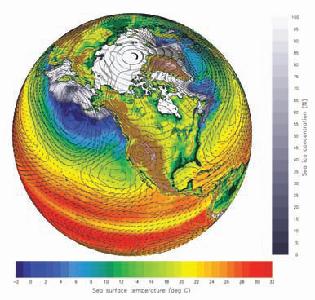
eResearch: data everywhere
Data collection
  Sensor networks, global databases, local databases, desktop computer, laboratory instruments, observation devices, etc.
Data processing, analysis, visualization
  Legacy codes, workflows, data mining, indexing, searching, graphics, screens, etc.
Archiving
  Digital repositories, libraries, preservation, etc.
SensorMap
  Functionality: Map navigation
  Data: sensor-generated temperature, video camera feed, traffic feeds, etc.
Scientific visualizations
  NSF Cyberinfrastructure report, March 2007
Notes:
6

Slide 7
The Problem for the eScientist / eResearcher
Experiments &
Instruments
facts
facts
?
questions
Other Archives
facts
answers
Literature
facts
Simulations
Data ingest
Managing petabytes+
Common schema(s)
How to organize?
How to re-organize?
How to coexist & cooperate with other scientists and researchers?
Data query and visualization tools
Support/training
Performance
  Execute queries in a minute
  Batch (big) query scheduling

Slide 8
Climatology
Biology
Astronomy
Chemistry
History
Astronomy
History
Earth Science
Biology
Researcher 2
Earth Science
Common Science Data Infrastructure
Researcher 1
Scientific World
Community Support Services
Chemistry
Data Services
Aggregation in broad disciplines
Non Scientific World
Earth Observation
Climatology
Crystallography
Ground Truth
Bio-chemistry
Earth Science
Physical chemistry
Separate disciplines

Slide 9
Source: High-level Group on Scientific Data
Climatology
Biology
Astronomy
Chemistry
Aggregated Data Sets
(Temporary or Permanent)
History
Other Data
Demography
Scientific Data
(Discipline Specific)
Workflows
Researcher 2
Aggregation Path
Researcher 1
Scientific World
API
Data Discovery & Navigation
Workflows Generation
Community Support Services
Data Services
Computing Infrastructure
Persistent Storage Capacity
Integrity
Authentication & Security
Non Scientific World

Slide 10

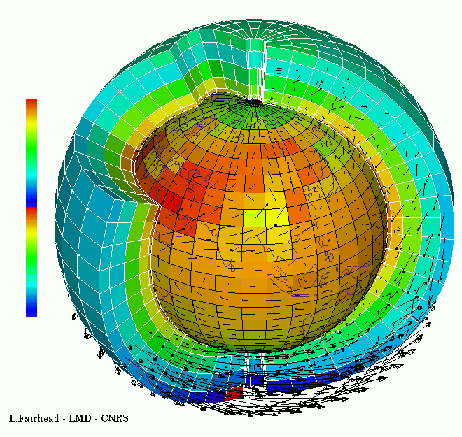

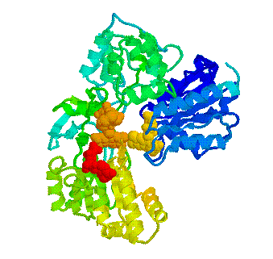
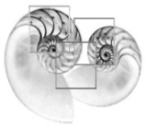
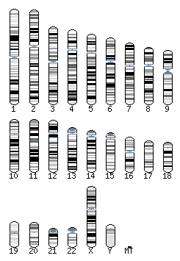


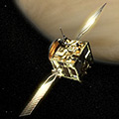
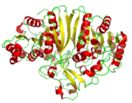
Global collaboratories
They can engage in whole new forms of scientific inquiry and treat information at a scale we are only beginning to see.
… and help us solving today’s Grand Challenges such as climate change and energy supply.

Slide 11
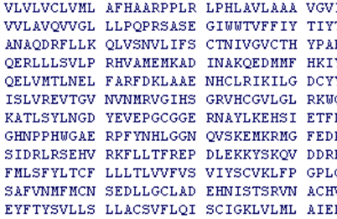
Global collaboratories
With a proper scientific e-Infrastructure, researchers in different domains can collaborate on the same data set, finding new insights.
They can share the data across the globe, protecting its integrity and checking its provenance.
They can use, re-use and combine data, increasing productivity.

Slide 12
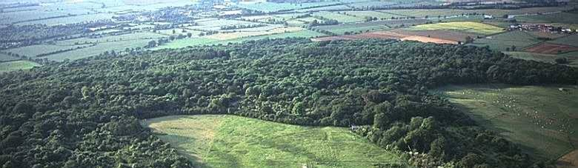
Large-scale e-Infrastructures for
Biodiversity Research
Notes:
12

Slide 13
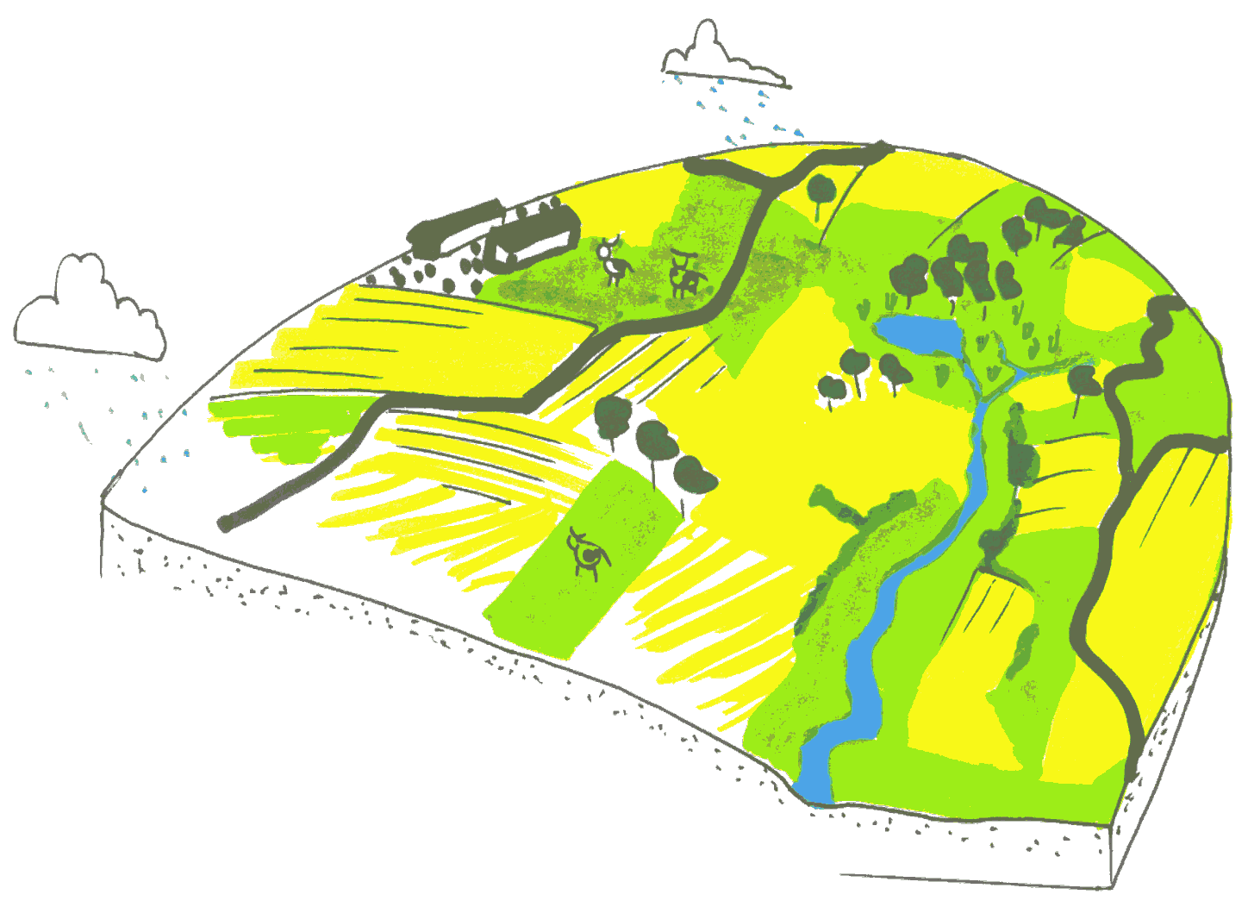
Experimentation on a few
parameters is not enough:
Limitations to scaling up
results for understanding
system properties
The biodiversity system is complex
and cannot be described by the simple
sum of its components and relations
LifeWatch adds a new technology to
support the generation and analysis
of large-scale data-sets on biodiversity.
Find patterns and learn processes.

Slide 14
Architecture
Collaboration
Common Exploratory Environment
Collaborative Virtual Organisations
Users
Semantic annotation
E-Infrastructure
Analysis and processing
• Integration of resources
• Documented, shared workflows
• Grid computation
Composition
Resources
Data • measurements,
observations & sensors
• other infrastructures (e.g. ELIXIR)
Statistical software
Distributed computing power

Slide 15

Vision 2030 high-level experts group on Scientific Data
“Our vision is a scientific e-Infrastructure that supports seamless access, use, re-use and trust of data. In a sense, the physical and technical infrastructure becomes invisible and the data themselves become the infrastructure – a valuable asset, on which science, technology, the economy and society can advance.”
  High-Level Group on Scientific Data
  “Riding the Wave: how Europe can gain from the raising tide of scientific data”

Slide 16
1990
2010
2030
Web not yet begun
XML not yet begin
Internet speeds kbps in universities and offices
300,000 internet hosts
Data volume ??
XXX researchers
Few computer programming languages
Transition from text to 2D image visualisation
Web 2.0 started
XML widespread
Internet speeds Mbps widespread
600,000,000 internet hosts
5.10¹⁸ bytes of data
Millions of researchers
Many new paradigms for programming languages
3-D and Virtual reality visualisation
Semantic Web
XML forgotten
Internet speeds Pbps widespread
2,000,000,000,000 hosts
5.10²⁴ bytes of data
Billions of citizen researchers
Natural language programming for computers
Virtual worlds

Slide 17
Vision 2030
(1) All stakeholders, from scientists to national authorities to general public are aware of the critical importance of preserving and sharing reliable data produced during the scientific process.
  All member states ought to publish their policies and implementation plans on the conservation and sharing of scientific data, aiming at a coordinated European approach.
  Legal issues are worked out so that they encourage, and not impede, global data sharing.
  The scientific community is supported to provide its data and metadata for re-use.
  Every funded science project includes a fixed budget percentage for compulsory conservation and distribution of data, spent depending of the project context.
  IMPACT IF ACHIEVED
  Data form an infrastructure, and are an asset for future science and the economy.

Slide 18
Vision 2030
(2) Researchers and practitioners from any discipline are able to find, access and process the data they need. They can be confident in their ability to use and understand data and they can evaluate the degree to which the data can be trusted.
  Create a robust, reliable, flexible, green, evolvable data framework with appropriate governance and long-term funding schemes to key services such as Persistent Identification and registries of metadata.
  Propose a directive demanding that data descriptions and provenance are associated with public (and other) data.
  Create a directive to set up a unified authentication and authorisation system.
  Set Grand Challenges to aggregate domains.
  Provide “forums” to define strategies at disciplinary and cross-disciplinary levels for metadata definition.
  IMPACT IF ACHIEVED
  Dramatic progress in the efficiency of the scientific process, and rapid advances in our understanding of our complex world, enabling the best brains to thrive wherever they are.

Slide 19
Vision 2030
(3) Producers of data benefit from opening it to broad access and prefer to deposit their data with confidence in reliable repositories. A framework of repositories work to international standards, to ensure they are trustworthy.
  Propose reliable metrics to assess the quality and impact of datasets.All agencies should recognise high quality data publication in career advancement.
  Create instruments so long-term (rolling) EU and national funding is available for the maintenance and curation of significant datasets.
  Help create and support international audit and certification processes.
  Link funding of repositories at EU and national level to their evaluation.
  Create the discipline of data scientist, to ensure curation and quality in all aspects of the system.
  IMPACT IF ACHIEVED
  Data-rich society with information that can be used for new and unexpected purposes.
  Trustworthy information is useable now and for future generations.

Slide 20
Vision 2030
(4) Public funding rises, because funding bodies have confidence that their investments in research are paying back extra dividends to society, through increased use and re-use of publicly generated data.
  EU and national agencies mandate that data management plans be created.
  IMPACT IF ACHIEVED
  Funders have a strategic view of the value of data produced.

Slide 21
Vision 2030
(5) The innovative power of industry and enterprise is harnessed by clear and efficient arrangements for exchange of data between private and public sectors allowing appropriate returns for both.
  Use the power of EU-wide procurement to stimulate more commercial offerings and partnerships.
  Create better collaborative models and incentives for the private sector to invest and work with science for the benefit of all.
  Create improved mobility and exchange opportunities.
  IMPACT IF ACHIEVED
  Commercial expertise is harnessed to the public benefit in a healthy economy.

Slide 22
Vision 2030
(6) The public has access and can make creative use of the huge amount of data available; it can also contribute to the data store and enrich it. All can be adequately educated and prepared to benefit from this abundance of information.
  Create non-specialist as well as specialist data access, visualisation, mining and research environments.
  Create annotation services to collect views and derived results.
  Create data recommender systems.
  Embed data science in all training and academic qualifications.
  Integrate into gaming and social networks
  IMPACT IF ACHIEVED
  Citizens get a better awareness of and confidence in sciences, and can play an active role in evidence based decision making and can question statements made in the media.

Slide 23
Vision 2030
(7) Policy makers can make decisions based on solid evidence, and can monitor the impacts of these decisions. Government becomes more trustworthy.
  Policy makers are able to make decisions based on solid evidence, and can monitor the impacts of these decisions. Government becomes more trustworthy.
  IMPACT IF ACHIEVED
  Policy decisions are evidence-based to bridge the gap between society and decision-making, and increase public confidence in political decisions.

Slide 24
Vision 2030
(8) Global governance promotes international trust and interoperability.
  Member states should publish their strategy, and resources, for implementation, by 2015.
  Create a European framework for certification for those coming up to an appropriate level of interoperability.
  Create a “scientific Davos” meeting to bring commercial and scientific domains together.
  IMPACT IF ACHIEVED
  We avoid fragmentation of data and resources.

Slide 25
Initial wish list
Open deposit, allowing user-community centres to store data easily
Bit-stream preservation, ensuring that data authenticity will be guaranteed for a specified number of years
Format and content migration, executing CPU-intensive transformations on large data sets at the command of the communities
Persistent identification, allowing data centres to register a huge amount of markers to track the origins and characteristics of the information
Metadata support to allow effective management, use and understanding
Maintaining proper access rights as the basis of all trust
A variety of access and curation services that will vary between scientific disciplines and over time
Execution services that allow a large group of researchers to operate on the stored date
High reliability, so researchers can count on its availability
Regular quality assessment to ensure adherence to all agreements
Distributed and collaborative authentication, authorisation and accounting“
A high degree of interoperability at format and semantic level
Adapted from the PARADE White Paper

Slide 26
Chair: John Wood - Secretary General of the Association of Commonwealth Universities
- Thomas Andersson - Professor of Economics and former President, Jönköping University; Senior Advisor, Science, Technology and Innovation, Sultanate of Oman
- Achim Bachem - Chairman, Board of Directors, Forschungszentrum Jülich GmbH
- Christoph Best - European Bioinformatics Institute, Cambridge (UK)/Google UK Ltd, London (from September 2010)
- Françoise Genova - Director, Strasbourg Astronomical Data Centre; Observatoire Astronomique de Strasbourg, Université de Strasbourg/CNRS
- Diego R. Lopez - RedIRIS
- Wouter Los - Faculty of Science at the University of Amsterdam; Coordinator of preparatory project LifeWatch biodiversity research infrastructure; Vice Chair Governing Board of GBIF
- Monica Marinucci - Director, Oracle Public Sector, Education and Research Business Unit
- Laurent Romary - INRIA and Humboldt University
- Herbert Van de Sompel - Staff Scientist, Los Alamos National Laboratory
- Jens Vigen - Head Librarian, European Organization for Nuclear Research, CERN
- Peter Wittenburg - Technical Director, Max Planck Institute for Psycholinguistics
Rapporteur: David Giaretta - STFC and Alliance for Permanent Access
Members of High Level Expert Group on Scientific Data

